Slide 1
Chapter 2
Instructions: Language of the Computer
Notes:
The University of Adelaide, School of Computer Science
Chapter 2 — Instructions: Language of the Computer

Slide 2
Representing Instructions
Instructions are encoded in binary
  Called machine code
MIPS instructions
  Encoded as 32-bit instruction words
  Small number of formats encoding operation code (opcode), register numbers, …
  Regularity!
Register numbers
  $t0 – $t7 are reg’s 8 – 15
  $t8 – $t9 are reg’s 24 – 25
  $s0 – $s7 are reg’s 16 – 23
§2.5 Representing Instructions in the Computer
Chapter 2 — Instructions: Language of the Computer — <number>
Notes:
The University of Adelaide, School of Computer Science
Chapter 2 — Instructions: Language of the Computer

Slide 3

Stored Program Computers
The BIG Picture
Instructions represented in binary, just like data
Instructions and data stored in memory
Programs can operate on programs
  e.g., compilers, linkers, …
Binary compatibility allows compiled programs to work on different computers
  Standardized ISAs
Chapter 2 — Instructions: Language of the Computer — <number>
Notes:
The University of Adelaide, School of Computer Science
Chapter 2 — Instructions: Language of the Computer

Slide 4
MIPS Instruction Formats
There are three formats in MIPS that represents all instructions (remember regularity simplifies the design!)
Each instruction mnemonic is translated into some binary code and so also the registers
To know the binary representation for mnemonics and registers look at the Green sheet attached to the book
R-format
(Register)
I-format
(Immediate)
J-format
(Jump)
Chapter 2 — Instructions: Language of the Computer — <number>

Slide 5
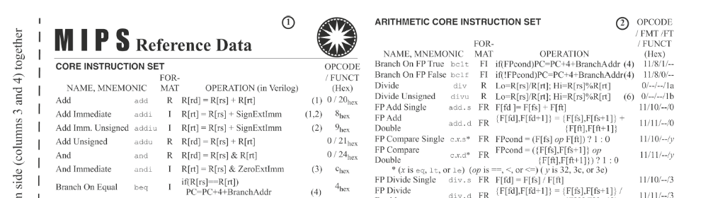
Green sheet!
Example of some instructions in the Green sheet
Chapter 2 — Instructions: Language of the Computer — <number>

Slide 6
MIPS R-format Instructions
op
rs
rt
rd
shamt
funct
6 bits
5 bits
5 bits
5 bits
5 bits
6 bits
Instruction fields
  op: operation code (opcode)
  rs: first source register number
  rt: second source register number
  rd: destination register number
  shamt: shift amount (00000 for now)
  funct: function code (extends opcode)
Chapter 2 — Instructions: Language of the Computer — <number>
Notes:
The University of Adelaide, School of Computer Science
Chapter 2 — Instructions: Language of the Computer

Slide 7
R-format Example - add
op
rs
rt
rd
shamt
funct
6 bits
5 bits
5 bits
5 bits
5 bits
6 bits
add $t0, $s1, $s2
unused
special
$s1
$s2
$t0
0
add
0
17
18
8
0
32
000000
10001
10010
01000
00000
100000
00000010001100100100000000100000₂ = 02324020₁₆
Chapter 2 — Instructions: Language of the Computer — <number>
Notes:
The University of Adelaide, School of Computer Science
Chapter 2 — Instructions: Language of the Computer

Slide 8
R-format Example - sll
op
rs
rt
rd
shamt
funct
6 bits
5 bits
5 bits
5 bits
5 bits
6 bits
shamt: how many positions to shift
Example
sll $t2,$s0,4
0
0
16
10
4
0
unused
Chapter 2 — Instructions: Language of the Computer — <number>
Notes:
The University of Adelaide, School of Computer Science
Chapter 2 — Instructions: Language of the Computer

Slide 9
MIPS I-format Instructions
op
rs
rt
constant or address
6 bits
5 bits
5 bits
16 bits
Immediate arithmetic and load/store instructions
  rt: destination or source register number
  Constant: –2¹⁵ to +2¹⁵ – 1
  Address: offset added to base address in rs
Example
  lw $t0,32($s3)
35
19
8
32
Chapter 2 — Instructions: Language of the Computer — <number>
Notes:
The University of Adelaide, School of Computer Science
Chapter 2 — Instructions: Language of the Computer

Slide 10
Branch Addressing
Branch instructions specify
  Opcode, two registers, target address
Most branch targets are near branch
  Forward or backward
op
rs
rt
constant or address
6 bits
5 bits
5 bits
16 bits
PC-relative addressing
  Target address = PC + offset × 4
  PC already incremented by 4 by this time
Chapter 2 — Instructions: Language of the Computer — <number>
Notes:
The University of Adelaide, School of Computer Science
Chapter 2 — Instructions: Language of the Computer

Slide 11
Branch Addressing Example
Example
bne $t0, $s5, Exit
New PC = Current PC + 2 × 4
5
8
21
2
Chapter 2 — Instructions: Language of the Computer — <number>

Slide 12
Jump Addressing
Jump (j and jal) targets could be anywhere in text segment
  Encode full address in instruction
op
address
6 bits
26 bits
(Pseudo)Direct jump addressing
  Target address = PC_{31…28} : (address × 4)
Chapter 2 — Instructions: Language of the Computer — <number>
Notes:
The University of Adelaide, School of Computer Science
Chapter 2 — Instructions: Language of the Computer

Slide 13
Target Addressing Example
Loop code from earlier example
  Assume Loop at location 80000
Loop: sll $t1, $s3, 2 | 80000 | 0 | 0 | 19 | 9 | 4 | 0
add $t1, $t1, $s6 | 80004 | 0 | 9 | 22 | 9 | 0 | 32
lw $t0, 0($t1) | 80008 | 35 | 9 | 8 | 0
bne $t0, $s5, Exit | 80012 | 5 | 8 | 21 | 2
addi $s3, $s3, 1 | 80016 | 8 | 19 | 19 | 1
j Loop | 80020 | 2 | 20000
Exit: … | 80024
Chapter 2 — Instructions: Language of the Computer — <number>
Notes:
The University of Adelaide, School of Computer Science
Chapter 2 — Instructions: Language of the Computer

Slide 14
Branching Far Away
If branch target is too far to encode with 16-bit offset, assembler rewrites the code
Example
  beq $s0,$s1, L1
  ↓
  bne $s0,$s1, L2
  j L1
  L2: …
Chapter 2 — Instructions: Language of the Computer — <number>
Notes:
The University of Adelaide, School of Computer Science
Chapter 2 — Instructions: Language of the Computer

